Slide 1
Ubiquitously Used Useful Utilities Unveiled
Mike Gossmann
@MikeGossmann

Slide 2
?

Slide 4
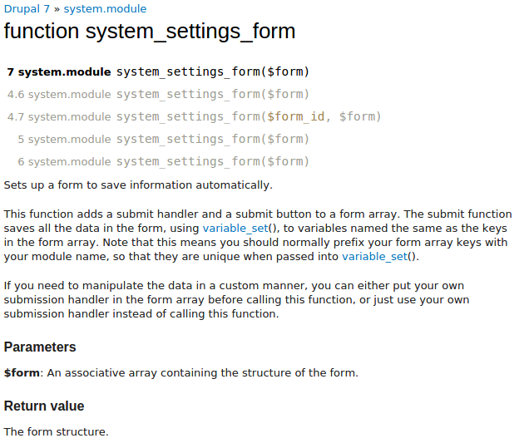

Slide 6
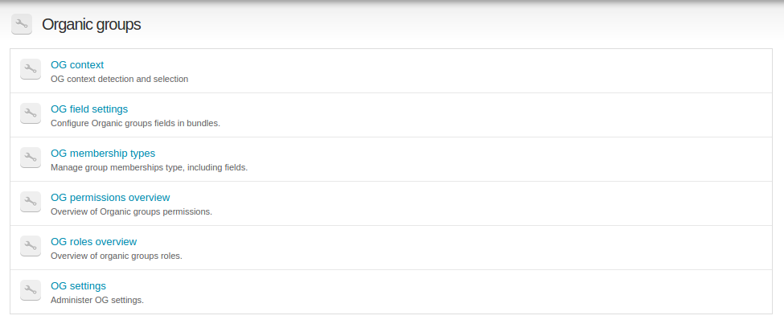
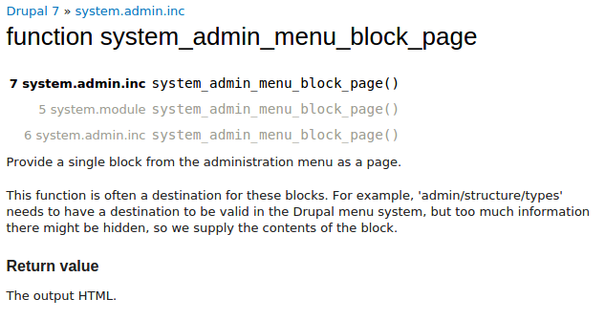
drupal.org/project/og

Slide 7
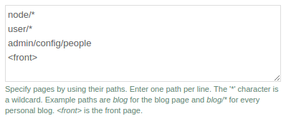

Slide 10
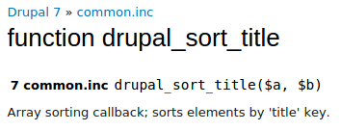
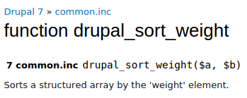
title
weight

Slide 11
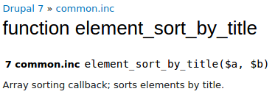
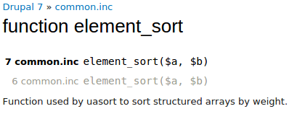
#title
#weight

Slide 12
JS

Slide 14
.load()
http://api.jquery.com/load/

Slide 15
Drupal.t()

Slide 16
Drupal.theme()

Slide 17
Review (PHP)
system_settings_form()
system_admin_menu_block_page()
drupal_match_path()
drupal_sort_title()
drupal_sort_weight()
element_sort_by_title()
element_sort()

Slide 18
Review (JS)
Drupal.behaviors
.load()
Drupal.t()
Drupal.theme()

Slide 19
Resources
api.drupal.org
api.drupal.org/api/drupal/includes%21common.inc/7
api.drupal.org/api/drupal/includes%21path.inc/7
api.drupal.org/api/drupal/includes%21system.inc/7
drupal.org/node/304258
drupal.org/node/305747

Slide 20
Thank You!
Mike Gossmann
@MikeGossmann

